Slide 1
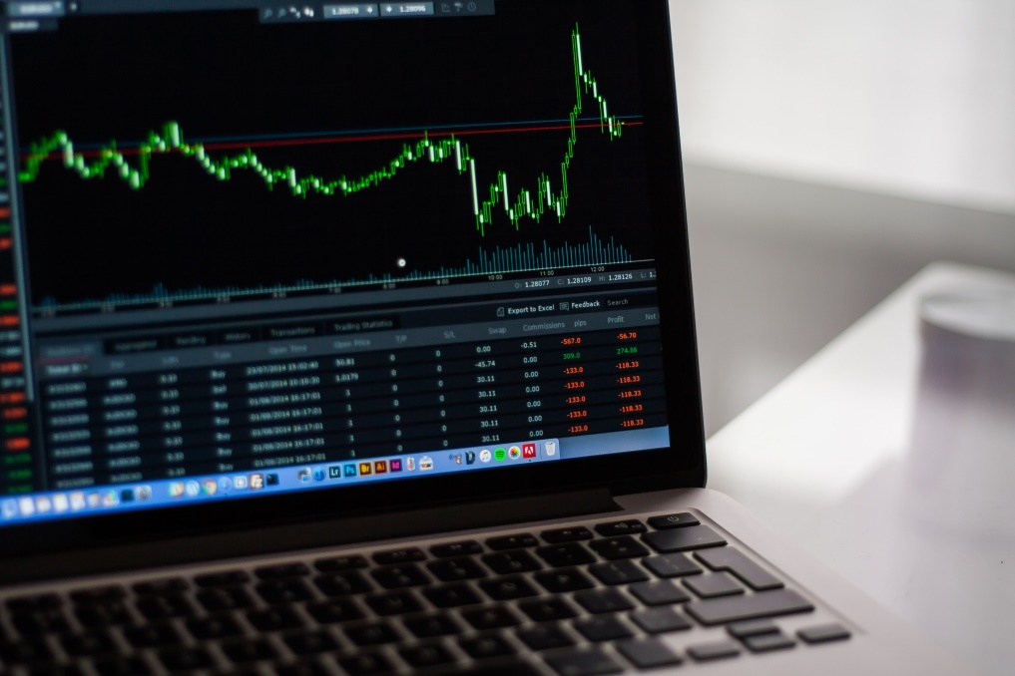
Presented By:-
Shubham Garg
Shreyash Mehta
ASET
CSE-V

Slide 2
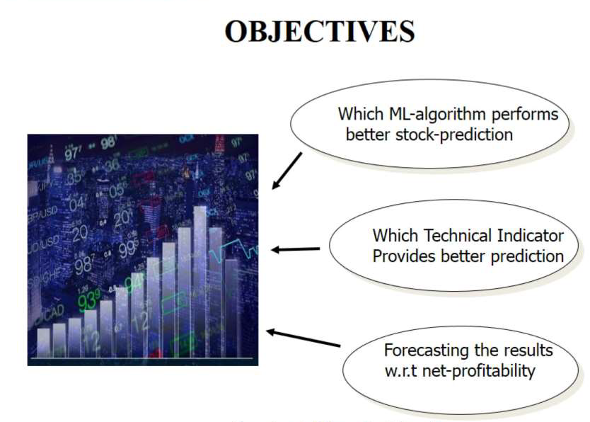

Slide 3
✓ To offer you an image of what the stock market is???
✓To answer the question: Can I predict price of a stock and if yes, to what extent?
✓To provide knowledge of some of the latest machine learning methods you can use in order to make profits on the stock market

Slide 4

The human is not a good analyzing machine by default: •People have no conscious experience of most of what is happening in their minds. •We tend to perceive what we expect to perceive. •Mind sets for quickly and are resisting to change. •New information is assimilated to existing images.
WHY ???

Slide 5
Incentive
Predicting stock performance is a very large and profitable area of study
Many companies have developed stock predictors based on neural networks
This technique has proven successful in aiding the decisions of investors
Can give an edge to beginning investors who don’t have a experience

Slide 6
Introduction
What is Trading?
Is the process of buying and selling financial instruments
What is Stock Market?
It is the market of trading
Stock market variation –demand & Supply strategy.
One of the main source for companies to raise money
Stock market is a widely used investment scheme promising high returns but it has some risks.
Why do we need Stock- Prediction Methodologies?
Stock market prediction is a act to forecast the future value of the stock market.
To assist inventors in decision making process for buying and selling of different securities.

Slide 7
Stock Terminologies
Earning Per Share
•(Free) Cash Flow per Share
•P/E Ratio
•Trends
•Inflation/Deflation
•Incidental transactions
•Demography
•Liquidity
•Volume
•Market sentiment
•Industry economic strength

Slide 8

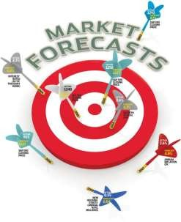
It comprises of the neural network trained using the back–propagation algorithm. Given a day’s open index, day’s high, day’s low, volume traded and the adjusted close values (all are in normalized form) will predict the closing index value for a given trading day. The above specified inputs correspond to the data that is observed after stock market closes every day.

Slide 9
Problem Description
Data was divided into 3 subsets Training set, Validation set, Generalization set.
Collect a sufficient amount of historical stock data.
Using the data train a neural network.
Once trained, the neural network can be used to predict stock behaviour.

Slide 10
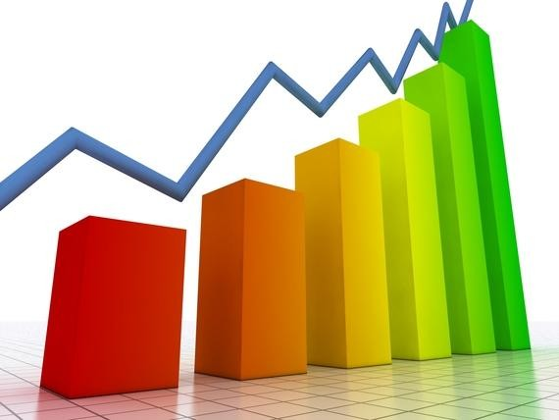
Problem Statement
The aim of the project is to examine a number of different forecasting techniques to predict future stock returns based on past returns and numerical news indicators to construct a portfolio of multiple stocks in order to diversify the risk. We do this by applying supervised learning methods for stock price forecasting by interpreting the seemingly chaotic market data.

Slide 11
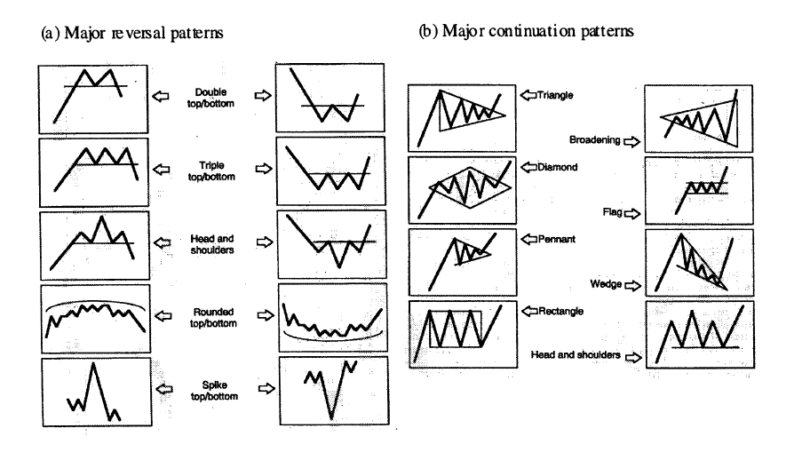
Motivation
Stock Prediction is more or less like Pattern Recognition
NN is a power tool for Pattern Regnition

Slide 12

Motivation
The fluctuation of stock market is violent and there are many complicated financial indicators. However, the advancement in technology, provides an opportunity to gain steady fortune from stock market and also can help experts to find out the most informative indicators to make better prediction. The prediction of the market value is of paramount importance to help in maximizing the profit of stock option purchase while keeping the risk low.

Slide 13
Models Used
We have used the following regression models for forecasting and comparison :
Neural Networks
Linear Regression
Random Forest Regression
Support Vector Regression
Decision Tree
Multilayer Perception

Slide 14
TOOL SPECIFICATION
Python
Sklearn
NumPy
Matplotlib
Quandl
Pandas

Slide 15
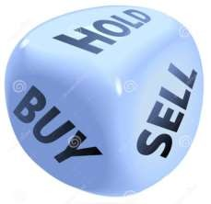
success and failures...
Advantages
Neural network can be trained with a very large amount of data. Years, decades, even centuries
Able to consider a “lifetime” worth of data when making a prediction
Completely unbiased
Disadvantages
No way to predict unexpected factors, i.e. natural disaster, legal problems, etc.

Slide 16
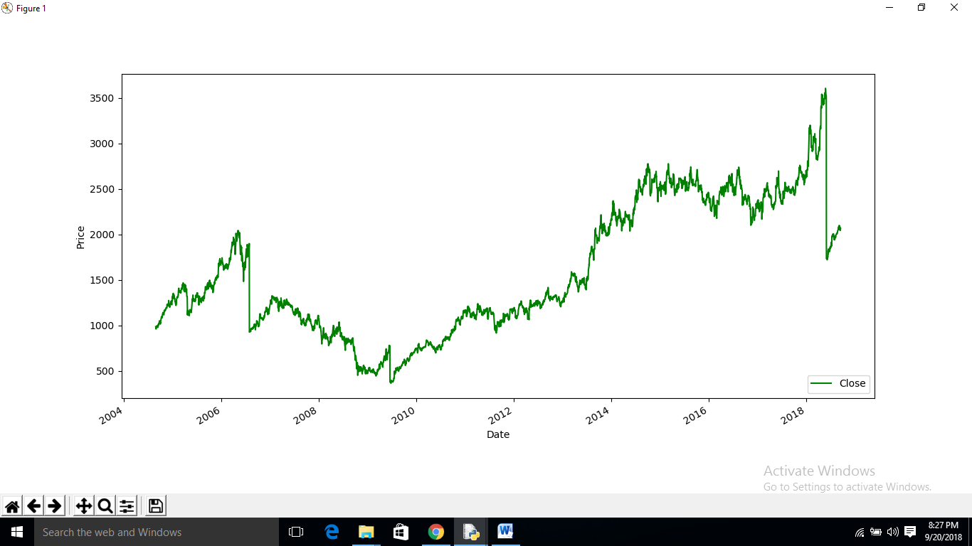
Dataset Plotting

Slide 17

Predicted Plot

Slide 18
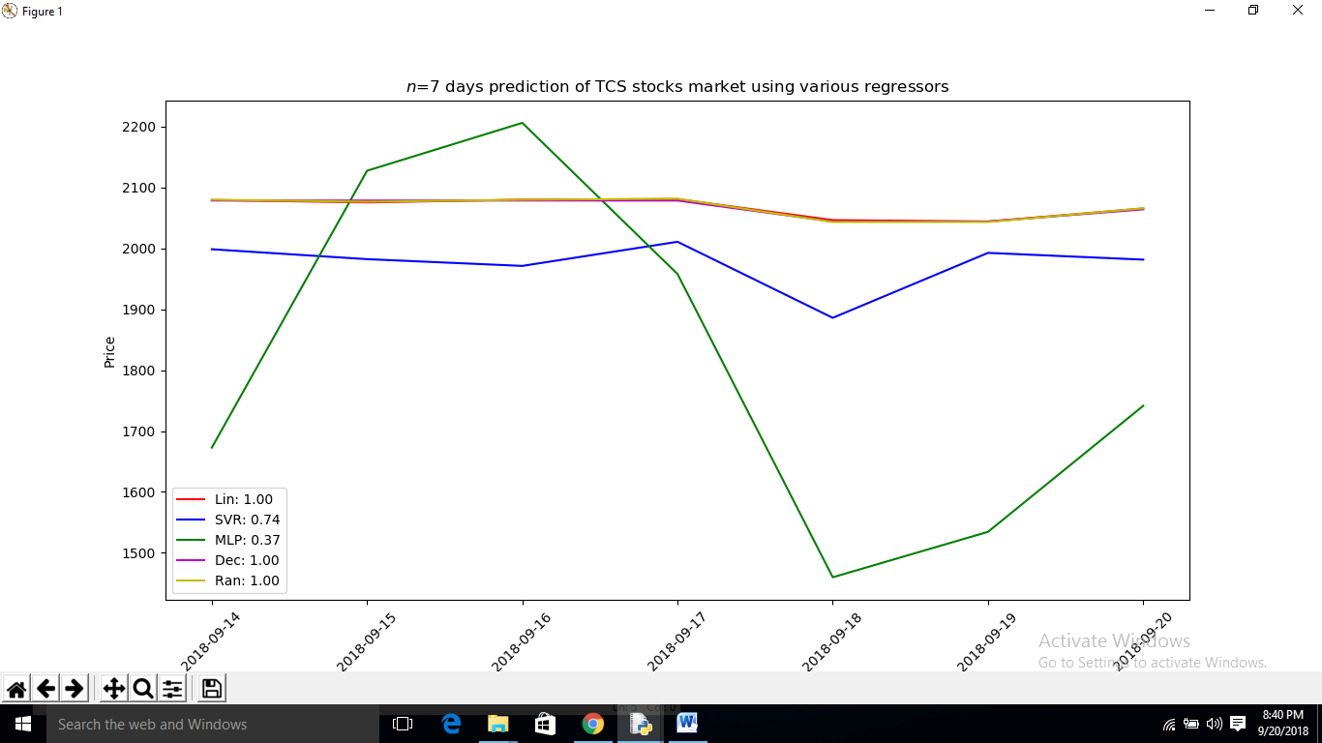
Comparison of Different Algorithm

Slide 19
Conclusion ....
No human or computer can perfectly predict the volatile stock market
Under “normal” conditions, in most cases, a good neural network will outperform most other current stock market predictors and be a very worthwhile, and potentially profitable aid to investors
Should be used as an aid only!

Slide 20
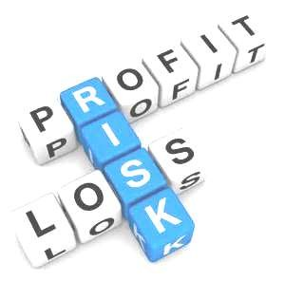
Warning ...
Stock values are subjected to market risks
please read the offer document carefully
before investing

Slide 21


